Slide 1
CS 451 term project presentation
Rory, Ben, Bruce, Tom, Denisa

Slide 2
Team member roles
Rory – Chief Architect/Group Leader, Engine Designer
Ben – Co-Pilot, Interface Programmer
Tom – Administrator, Main Documentor
Bruce – Tester
Denisa – Tester, Documentor

Slide 3
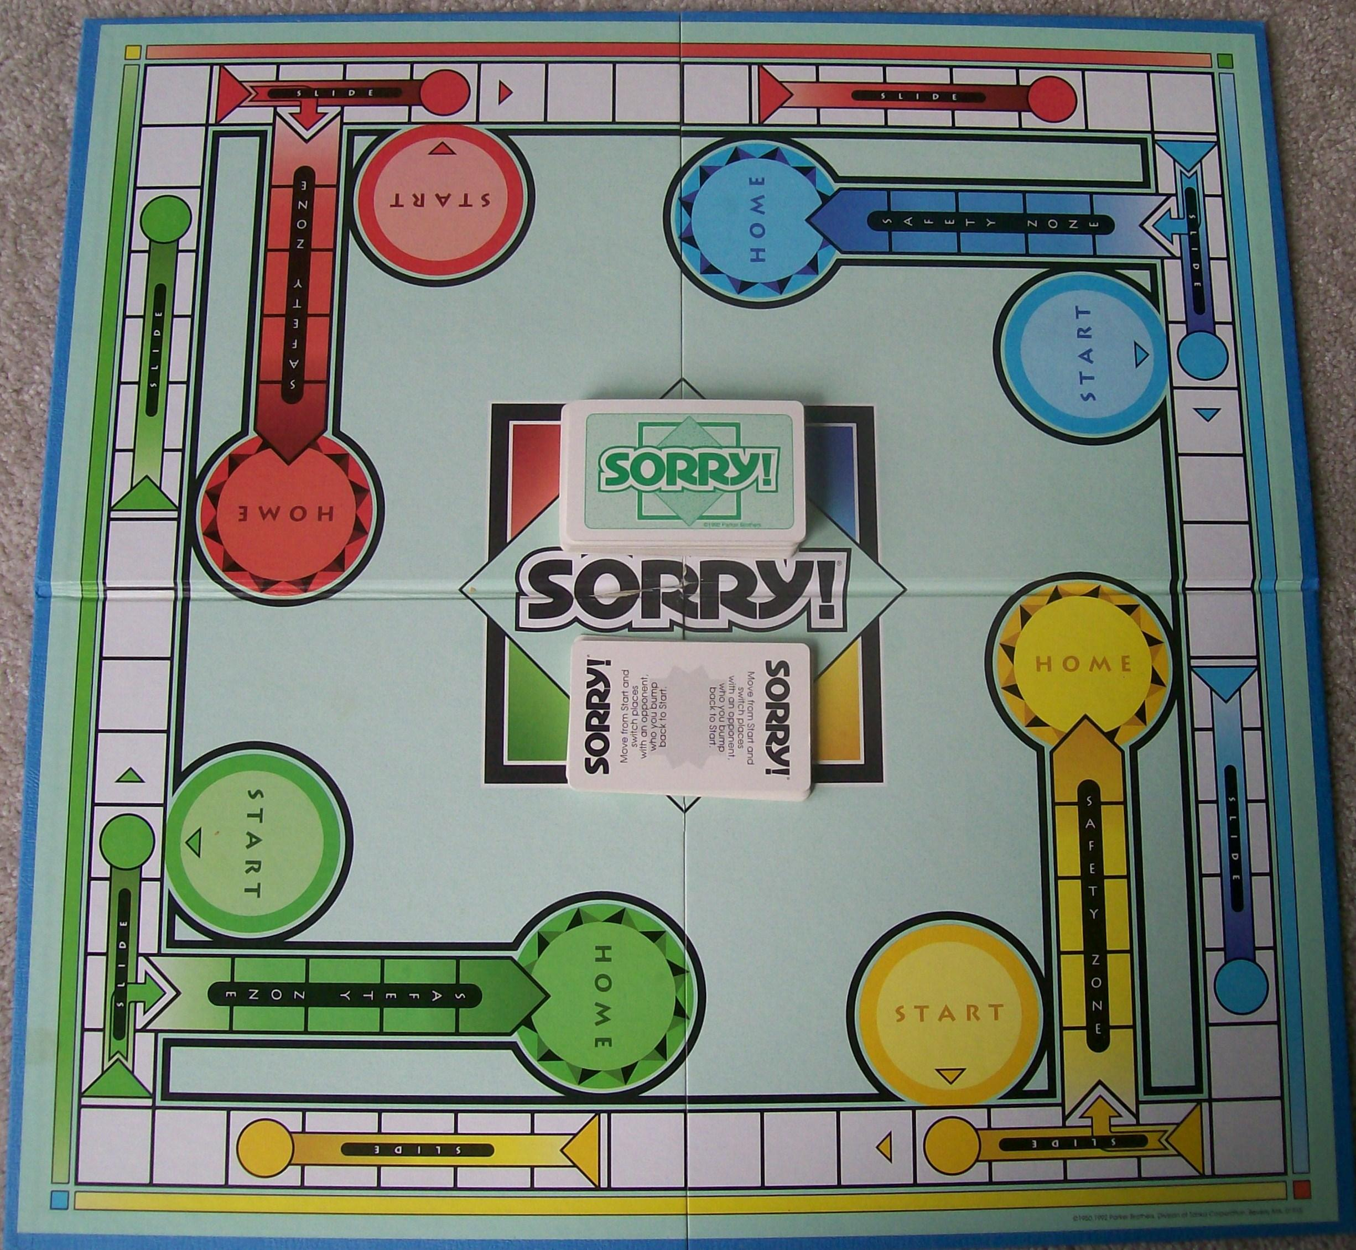
Our program: a clone of Sorry!
A virtual board game.
In Java, for desktop computers.
Using different name due to Hasbro trademark.

Slide 4
Main menu
Apologies
New Game
Quit

Slide 5
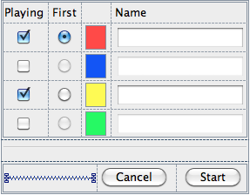
Player Setup
Choose two to four players
“Start” is only enabled when ≥2 players checked
Enter player names
Choose who goes first. (Play proceeds clockwise.)
Player Setup

Slide 6
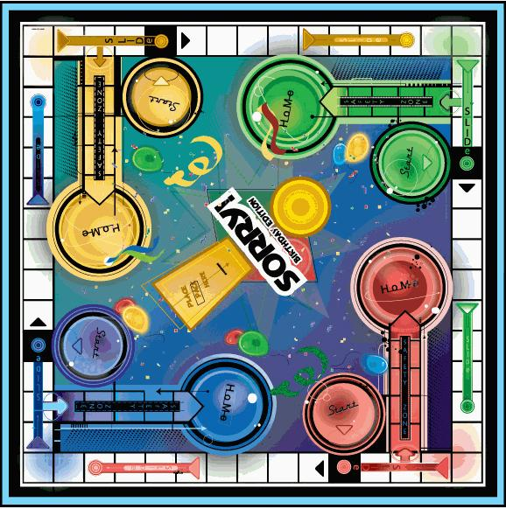
The game board
Start (Yellow’s)
Safe Zone Entry Space
draw pile (cards face-down)
discard pile (played cards, face-up)
Safe Zone (Yellow’s)
Home (Yellow’s)
1
a square
Start (Blue’s; currently contains all four of his pawns)
a pawn (one of Yellow’s)
All four players have the same board features of their color as each other.
Missing players’ areas are empty. They have no pawns and their turns are skipped.
slide end
a Red slide
slide start

Slide 7
The deck of cards
5 × “1” card
4 × “2” card
4 × “3” card
4 × “4” card
4 × “5” card
4 × “7” card
4 × “8” card
4 × “10” card
4 × “11” card
4 × “12” card
4 × “My Apologies” card
The deck is shuffled before play.

Slide 8
Safe Zone rules
At a fork for a safe zone (Safe Zone Entry Space), same-color players must move into the safe zone, and different-color players must move around the outside. The move paths for these two situations are shown in the diagrams to the right.
When moving along the outside track, you cannot move forward past your color’s safe zone.
Pawns are safe from being targeted by an 11 or My Apologies if in a safe zone.
Pawns cannot move backwards into a safe zone, but they can move backwards around the outside, and then forwards into a safe zone on another turn.
Blue at safe zone entry space; safe zone along magenta line
Yellow moving around opposing safe zone

Slide 9
At game start
Each player starts with 4 pawns
The objective is to get all 4 pawns home
Movement by drawing cards; can only move out of Start on 1 or 2
1
5
✓ Blue can move
✗ Blue can’t move

Slide 10
At turn start – draw a card
Apologies
At the start of every turn, the player must draw a card by clicking the deck. The drawn card will then be placed next to the deck.
1
John Smith’s turn
Draw a card.

Slide 11
Bumping
Apologies
If you move past a pawn, you count it as a normal space. But if you land on another player’s pawn, that pawn is sent back to the start. (“Apologies.”)
5
John Smith’s turn
Move forward 5.

Slide 12
Sliding
Apologies
If your piece lands at the beginning of a slide that is not your color, it slides to the end of the slide, bumping any pawns in the way.
5
John Smith’s turn
Move forward 5.

Slide 13
1 card
Apologies
Either start a pawn OR move one pawn forward 1 space.
1
John Smith’s turn
forward 1
start a pawn

Slide 14
2 card
Apologies
Either start a pawn OR move one pawn forward 2 spaces.
DRAW AGAIN and move accordingly.
2
John Smith’s turn
forward 2
start a pawn
You will take another turn after this one.

Slide 15
3 card
Apologies
Move one pawn forward 3 spaces.
3
John Smith’s turn
Move forward 3.

Slide 16
4 card
Apologies
Move one pawn backward 4 spaces.
4
John Smith’s turn
Move backwards 4.

Slide 17
5 card
Apologies
Move one pawn forward 5 spaces.
5
John Smith’s turn
Move forward 5.

Slide 18
7 card
Apologies
Either move one pawn forward 7 spaces—OR split the forward move between any two pawns.
7
John Smith’s turn
4 moves remaining
Reset

Slide 19
8 card
Apologies
Move one pawn forward 8 spaces
8
John Smith’s turn
Move forward 8.

Slide 20
10 card
Apologies
Either move one pawn forward 10 spaces—OR move one pawn backward 1 space
10
John Smith’s turn
forward 10
backward 1

Slide 21
11 card
Either move one pawn forward 11 spaces—OR switch any one of your pawns with one of any opponent’s.
Notes:
You may forfeit a switch if you wish and it is impossible to move forward 11 spaces
You may only use 11 for pawns in the open track
If your switch landed you at the beginning of an opponent’s slide, slide to the end
Apologies
11
John Smith’s turn
forward 11
switch with opponent

Slide 22
12 card
Apologies
Move one pawn forward 12 spaces
12
John Smith’s turn
Move forward 12.

Slide 23
My Apologies card
Take one pawn from your START, place it on any space that is occupied by any opponent, and BUMP the opponent’s pawn back to its START.
If there is no pawn on your START or no opponent’s pawn on any space you can move to, you forfeit the move
Apologies
MA
John Smith’s turn
Choose a pawn to bump and replace with a pawn of yours from Start.

Slide 24

Highlighting – normal and on hover
Apologies
All pieces moveable with the current action selection on the board are always highlighted.
Also, when the mouse hovers over a moveable piece, the destination space, if applicable, is temporarily highlighted in a different color.
10
John Smith’s turn
forward 10
backward 1

Slide 25
If can’t use drawn card
Apologies
If you are unable to legally use any effects of the drawn card, or your only possible moves would make a pawn of yours land on another pawn of yours, you can do nothing but end your turn.
5
John Smith’s turn
You have no way to play this card.
End Turn

Slide 26
Additional rules
If you can move (without bumping yourself, as explained earlier), you must move.
If a player would draw but the draw pile is empty, the discard pile is reshuffled into the deck before the draw.

Slide 27
Exiting an in-progress game
There will be a “Game” menu in the menu bar with a menu item “Exit Game”. That would return you to the main menu.
Game
Exit Game

Slide 28
Game end screen
Apologies
“Restart” starts again with the same players
“New Game” goes to Player Setup
12
John Smith wins!
Restart
Quit
New Game

Slide 29
Team Schedule
Following Agile Methodology
Four two-week sprints
Milestones (HW assignments) at the end of each sprint
Finished by end of week 9

Slide 30
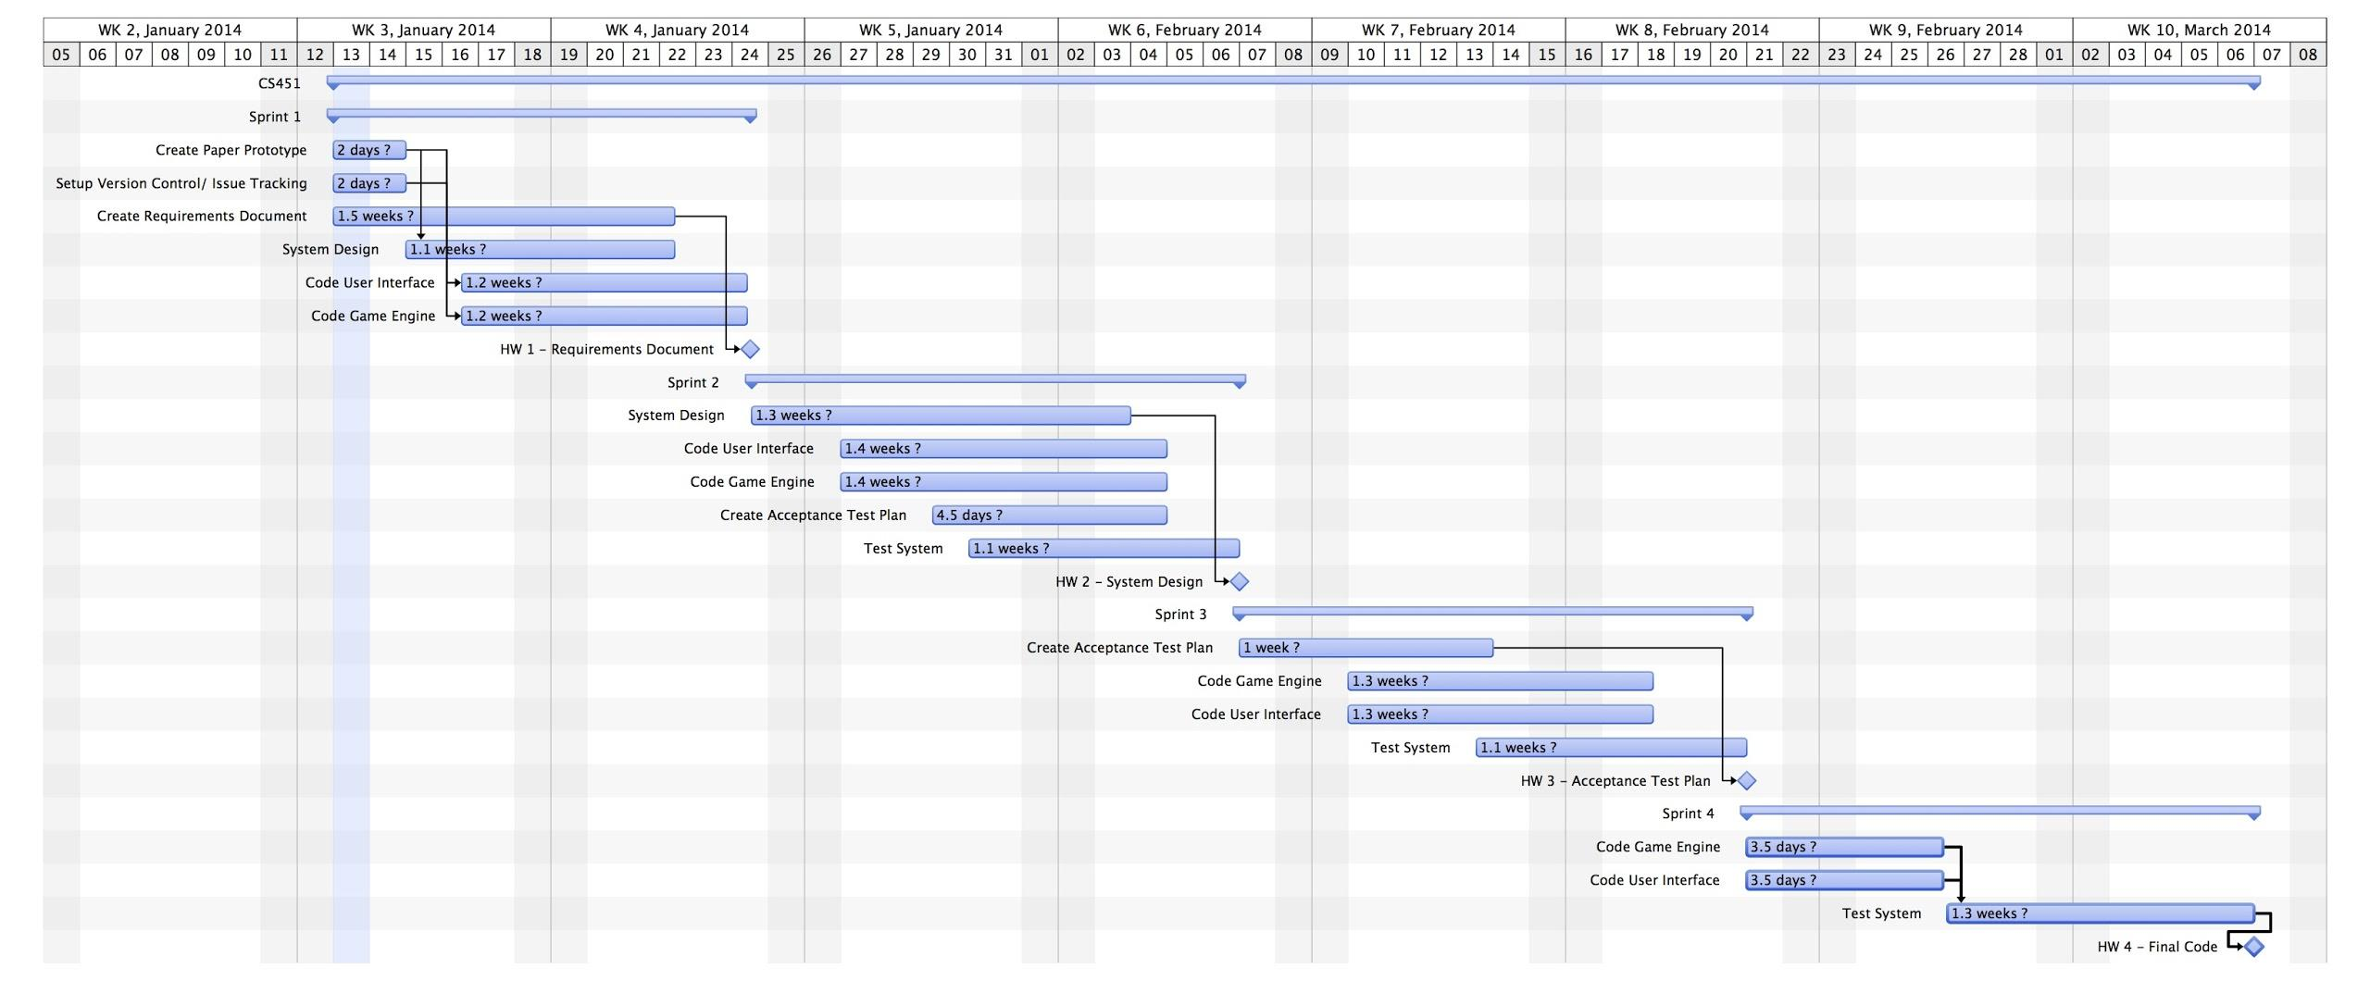

Slide 31
Optional features, if have time
rotate board to face current player
sound effects
keyboard shortcuts
support the 5-card hand rules “for adults”
AI players
save and load in-progress games
networked multiplayer

